Slide 2
Genetics of sex
Women & men are very different, but just a few genes create that difference
In mammals = 2 sex chromosomes
X & Y
2 X chromosomes = female: XX
X & Y chromosome = male: XY
X
X
X
Y

Slide 3
Sex chromosomes

Slide 4
Sex-linked traits
Sex chromosomes have other genes on them, too
especially the X chromosome
hemophilia in humans
blood doesn’t clot
Duchenne muscular dystrophy in humans
loss of muscle control
red-green color blindness
see green & red as shades of grey
X
X
X
Y
Notes:
Duchenne muscular dystrophy affects one in 3,500 males born in the United States.
Affected individuals rarely live past their early 20s.
This disorder is due to the absence of an X-linked gene for a key muscle protein, called dystrophin.
The disease is characterized by a progressive weakening of the muscles and loss of coordination.

Slide 5
Sex-linked traits
sex-linked recessive
X^{H}Y
2 normal parents,
but mother is carrier
HH
X^{H}X^{h}
x
Hh
X^{H}
male / sperm
X^{H}
Y
X^{H}Y
Y
X^{H}Y
X^{H}X^{H}
X^{H}Y
X^{H}
X^{H}X^{H}
female / eggs
X^{H}
X^{h}
X^{h}Y
X^{H}X^{h}
X^{h}Y
X^{H}X^{h}
X^{H}X^{h}
X^{h}

Slide 7
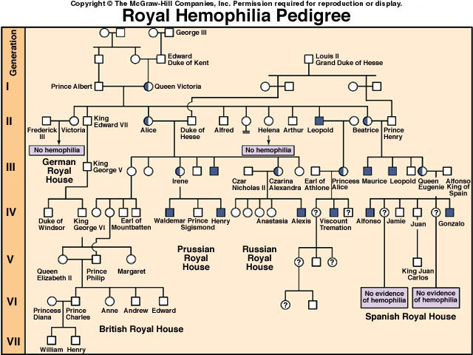
Notes:
Hemophilia is a sex-linked recessive trait defined by the absence of one or more clotting factors.
These proteins normally slow and then stop bleeding.
Individuals with hemophilia have prolonged bleeding because a firm clot forms slowly.
Bleeding in muscles and joints can be painful and lead to serious damage.
Individuals can be treated with intravenous injections of the missing protein.

