Slide 1
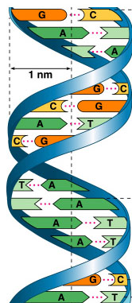
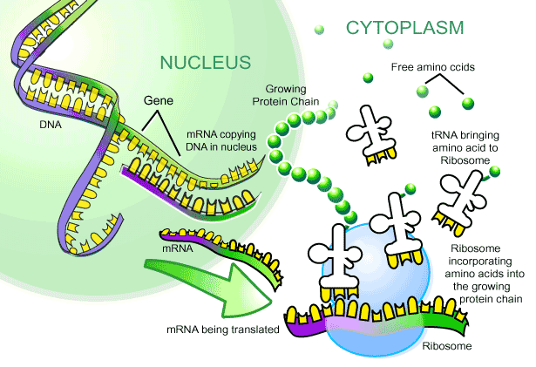
Protein Synthesis
Making Proteins

Slide 2
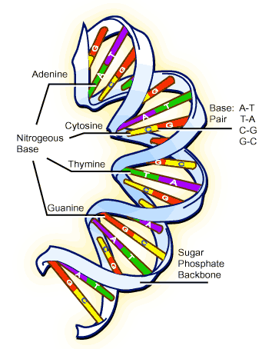
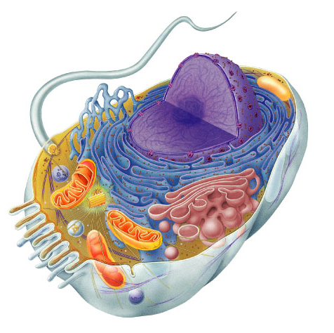
Bodies → Cells → DNA
Bodies are made up of cells
All cells run on a set of instructions spelled out in DNA

Slide 3
DNA → Cells → Bodies
How does DNA code for cells & bodies?
  how are cells and bodies made from the instructions in DNA

Slide 4
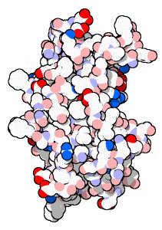
DNA → Proteins → Cells → Bodies
DNA has the information to build proteins
  genes
proteins
cells
DNA gets all the glory,
Proteins do all the work
bodies

Slide 5
How do proteins do all the work
Proteins
  proteins run living organisms
  enzymes
    control all chemical reactions in living organisms
  structure
    all living organisms are built out of proteins

Slide 6
Cell organization
DNA
  DNA is in the nucleus
    genes = instructions for making proteins
  want to keep it there = protected
    “locked in the vault”
cytoplasm
nucleus

Slide 7
Cell organization
Proteins
  chains of amino acids
  made by a “protein factory” in cytoplasm
  protein factory = ribosome
cytoplasm
build
proteins
nucleus
ribosome

Slide 8
Passing on DNA information
Need to get DNA gene information
from nucleus to cytoplasm
  need a copy of DNA
  messenger RNA
cytoplasm
build
proteins
mRNA
nucleus
ribosome

Slide 9
From nucleus to cytoplasm
transcription
DNA
mRNA
protein
translation
trait
nucleus
cytoplasm

Slide 10
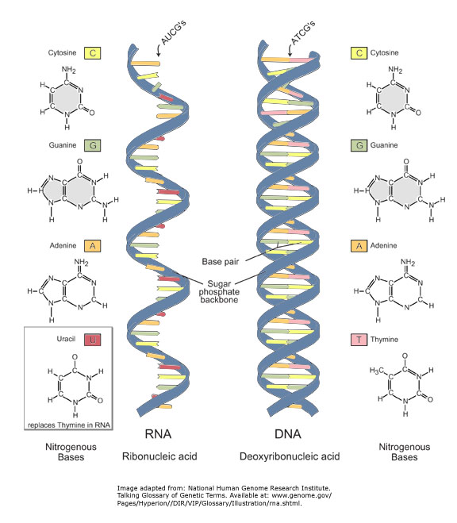
DNA vs. RNA
DNA
deoxyribose sugar
nitrogen bases
  G, C, A, T
  T : A
  C : G
double stranded
RNA
ribose sugar
nitrogen bases
  G, C, A, U
  U : A
  C : G
single stranded

Slide 11
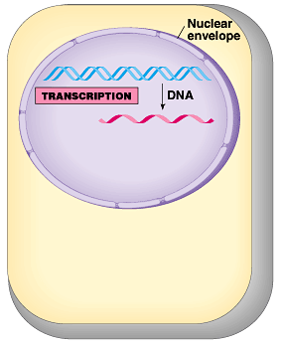
Transcription
Making mRNA from DNA
DNA strand is the
template (pattern)
  match bases
    U : A
    G : C
Enzyme
  RNA polymerase

Slide 12
Matching bases of DNA & RNA
Double stranded DNA unzips
T
G
G
T
A
C
A
G
C
T
A
G
T
C
A
T
C
G
T
A
C
C
G
T

Slide 13
Matching bases of DNA & RNA
Double stranded DNA unzips
T
G
G
T
A
C
A
G
C
T
A
G
T
C
A
T
C
G
T
A
C
C
G
T

Slide 14
Matching bases of DNA & RNA
A
Match RNA bases to DNA bases on one of the DNA strands
C
G
U
G
A
U
G
U
C
U
C
G
A
A
C
U
A
G
A
C
U
RNA
polymerase
A
A
C
C
G
T
G
G
T
A
C
A
G
C
T
A
G
T
C
A
T
C
G
T
A
C
C
G
T

Slide 15
Matching bases of DNA & RNA
U instead of T is matched to A
DNA
TACGCACATTTACGTACGCGG
mRNA
AUGCGUGUAAAUGCAUGCGCC
ribosome
A
C
C
A
U
G
U
C
G
A
U
C
A
G
U
A
G
C
A
U
G
G
C
A

Slide 16
cytoplasm
protein
nucleus
ribosome
A
C
C
A
U
G
U
C
G
A
U
C
A
G
U
A
G
C
A
U
G
G
C
A
trait

Slide 17
How does mRNA code for proteins
mRNA leaves nucleus
mRNA goes to ribosomes in cytoplasm
Proteins built from instructions on mRNA
How?
mRNA
A
C
C
A
U
G
U
C
G
A
U
C
A
G
U
A
G
C
A
U
G
G
C
A
aa
aa
aa
aa
aa
aa
aa
aa

Slide 18
How does mRNA code for proteins?
DNA
TACGCACATTTACGTACGCGG
ribosome
mRNA
AUGCGUGUAAAUGCAUGCGCC
?
protein
Met Arg Val Asn Ala Cys Ala
aa
aa
aa
aa
aa
aa
aa
aa
How can you code for 20 amino acids with
only 4 DNA bases (A,U,G,C)?

Slide 19
mRNA codes for proteins in triplets
DNA
TACGCACATTTACGTACGCGG
codon
AUGCGUGUAAAUGCAUGCGCC
AUGCGUGUAAAUGCAUGCGCC
mRNA
ribosome
mRNA
?
protein
Met Arg Val Asn Ala Cys Ala
Codon = block of 3 mRNA bases

Slide 20
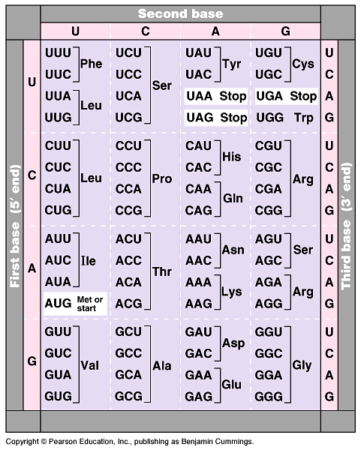
The mRNA code
For ALL life!
  strongest support for a common origin for all life
Code has duplicates
  several codons for each amino acid
  mutation insurance!
Start codon
  AUG
  methionine
Stop codons
  UGA, UAA, UAG
Notes:
Strong evidence for a single origin in evolutionary theory.

Slide 21
How are the codons matched to amino acids?
DNA
TACGCACATTTACGTACGCGG
mRNA
AUGCGUGUAAAUGCAUGCGCC
codon
UAC
GCA
tRNA
CAU
anti-codon
Met
amino
acid
Arg
Val
Anti-codon = block of 3 tRNA bases

Slide 22
mRNA to protein = Translation
The working instructions → mRNA
The reader → ribosome
The transporter → transfer RNA (tRNA)
ribosome
mRNA
A
C
C
A
U
G
U
C
G
A
U
C
A
G
U
A
G
C
A
U
G
G
C
A
U
G
G
aa
U
A
C
tRNA
A
G
C
aa
tRNA
U
A
G
aa
aa
tRNA
aa
tRNA
aa

Slide 23
From gene to protein
aa
aa
transcription
translation
aa
protein
DNA
mRNA
aa
aa
aa
aa
ribosome
A
C
C
A
U
G
U
C
G
A
U
C
A
G
U
A
G
C
A
U
G
G
C
A
tRNA
trait
nucleus
cytoplasm
aa

Slide 24
cytoplasm
protein
transcription
translation
nucleus
trait

Slide 25
From gene to protein
protein
transcription
translation

Slide 26
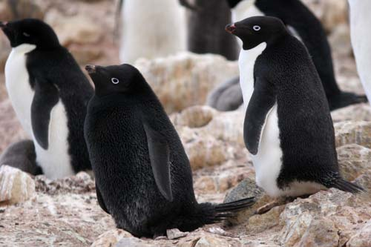
Whoops!
See what happens when
your genes don’t work right!
Any Questions??

