Slide 1

Evidence for Evolution
by
Natural Selection
Chapter 15
Hunting for evolution clues… Elementary, my dear, Darwin!

Slide 2
Evidence supporting evolution
Fossil record
  shows change over time
Anatomical record
  comparing body structures
    homology & vestigial structures
    embryology & development
Geographical Distribution
  Organisms that live in similar
  environments have similar features
Artificial selection
  human caused evolution

Slide 3
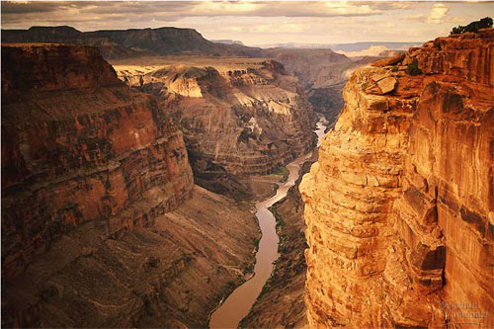
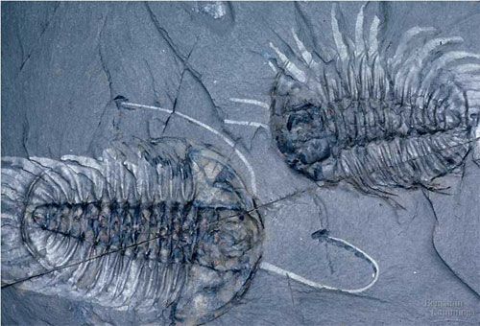
1. Fossil record
Layers of rock contain fossils
  new layers cover older ones
    creates a record over time
  fossils show a series of organisms have lived on Earth
    over a long period of time

Slide 4
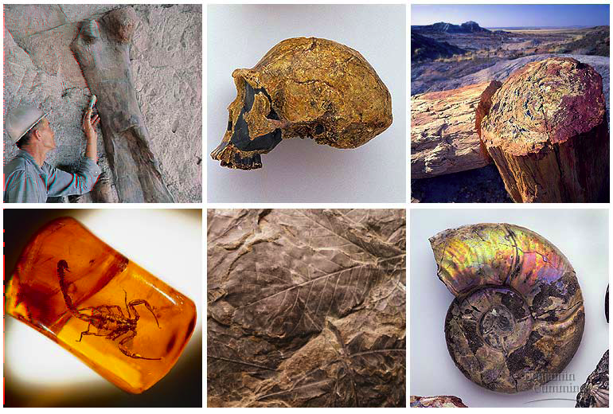
Fossils tell a story…
the Earth is old
Life is old
Life on Earth has changed

Slide 5
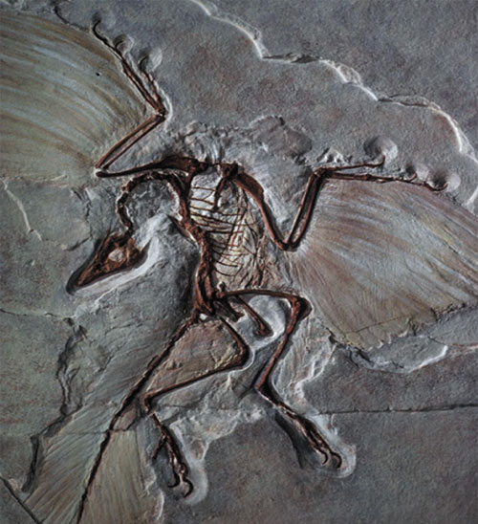
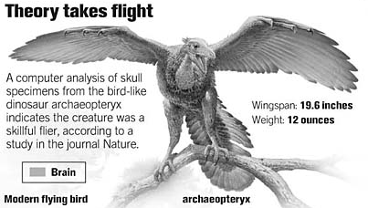
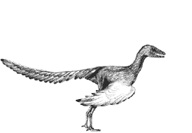
Evolution of birds
Today’s organisms descended from ancestral species
Fossil of Archaeopteryx
lived about 150 mya
links reptiles & birds
Notes:
The avian nature of the brain and inner ear of Archaeopteryx (Alonso et al. 2004) - Archaeopteryx, the earliest known flying bird from the Late Jurassic period, exhibits many shared primitive characters with more basal coelurosaurian dinosaurs (the clade including all theropods more bird-like than Allosaurus), such as teeth, a long bony tail and pinnate feathers. However, Archaeopteryx possessed asymmetrical flight feathers on its wings and tail, together with a wing feather arrangement shared with modern birds. This suggests some degree of powered flight capability but, until now, little was understood about the extent to which its brain and special senses were adapted for flight. Alonso et al. (2004) investigated this problem by computed tomography scanning and three-dimensional reconstruction of the braincase of the London specimen of Archaeopteryx. A reconstruction of the braincase and endocasts of the brain and inner ear suggest that Archaeopteryx closely resembled modern birds in the dominance of the sense of vision and in the possession of expanded auditory and spatial sensory perception in the ear. Alonso et al. (2004) concluded that Archaeopteryx had acquired the derived neurological and structural adaptations necessary for flight. An enlarged forebrain suggests that it had also developed enhanced somatosensory integration with these special senses demanded by a lifestyle involving flying ability.

Slide 6
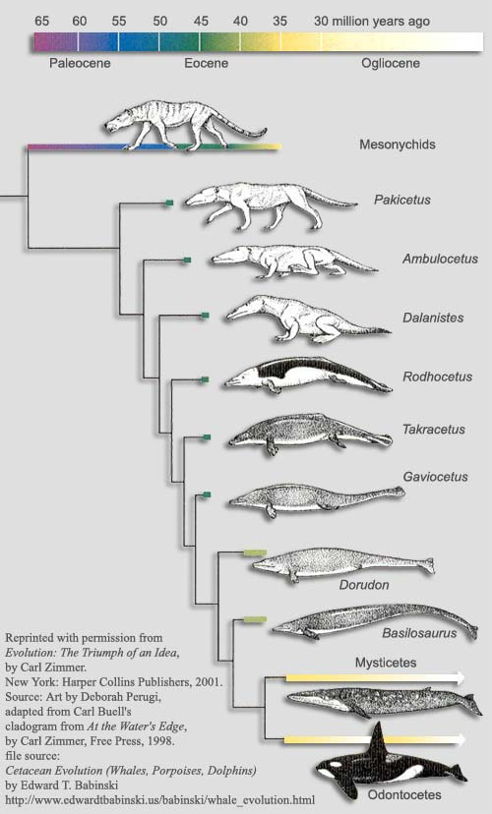
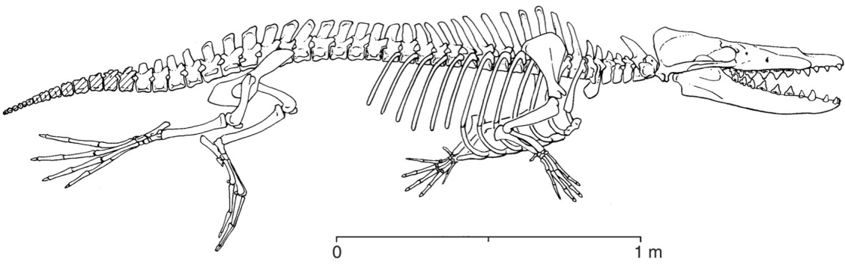
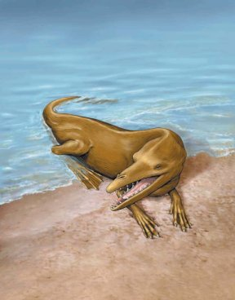
We found the fossil — no joke!
Land Mammal
?
?
Where are the
intermediate fossils?
?
Complete series
of transitional
fossils
?
Someone’s idea of a joke!
But the joke’s on them!!
Ocean Mammal
Notes:
There are innumerable intermediate & transitional forms
Whales as land creatures returning to the water….
Where are the intermediate forms of whale ancestors?
Cartoon making fun of this idea.
The cartoons disappeared 10-12 years ago when this fossil was found.
Ambilocetic natans = “Walking whale who likes to swim”
4-5 intermediate forms all found in last 2 decades
Indus River valley in between India & Pakistan.

Slide 7
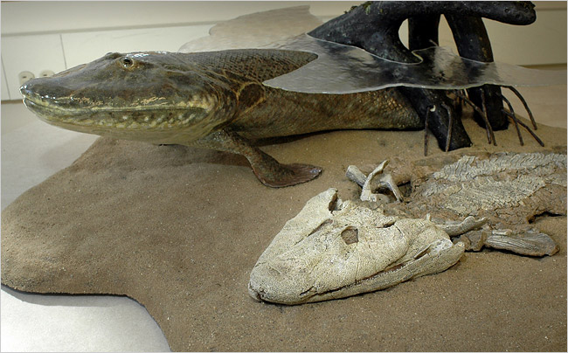
Evolution from sea to land
2006 fossil discovery of early tetrapod
  4 limbs
Missing link from sea to land animals

Slide 8
2. Anatomical record
Animals with different structures on the surface
But when you look under the skin…
It tells an evolutionary story of common ancestors

Slide 9
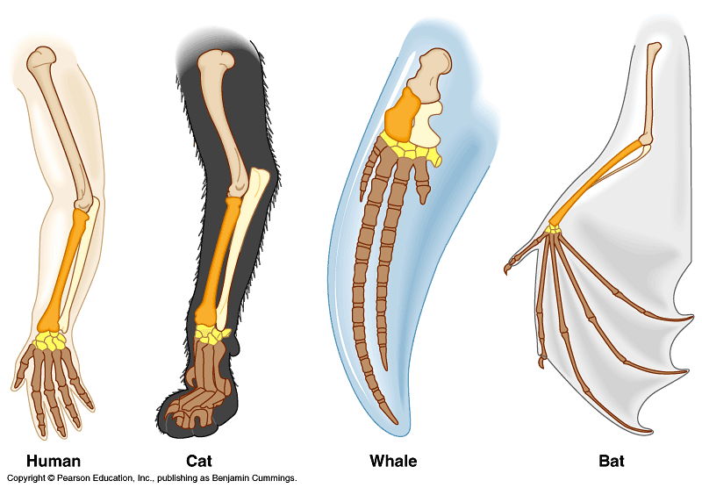
Compare the bones
The same bones under the skin
  limbs that perform different functions are built from the same bones
How could these
very different animals
have the
same bones?

Slide 10
Homologous structures
Structures that come from the same origin
    homo- = same
    -logous = information
Forelimbs of human, cats, whales, & bats
  same structure
    on the inside
  same development in embryo
  different functions
    on the outside
  evidence of common ancestor

