Slide 1
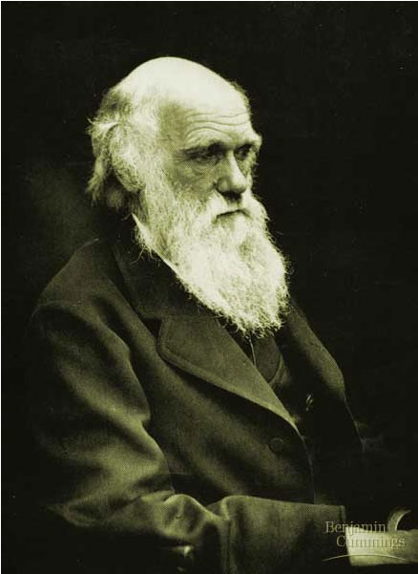
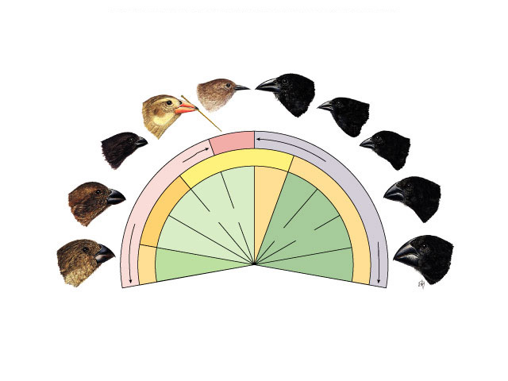
Darwin’s Theory of Evolution
Chapter 15
Warbler
finch
Cactus
eater
Tree finches
Ground finches
Insect eaters
Seed eaters
Bud eater

Slide 2
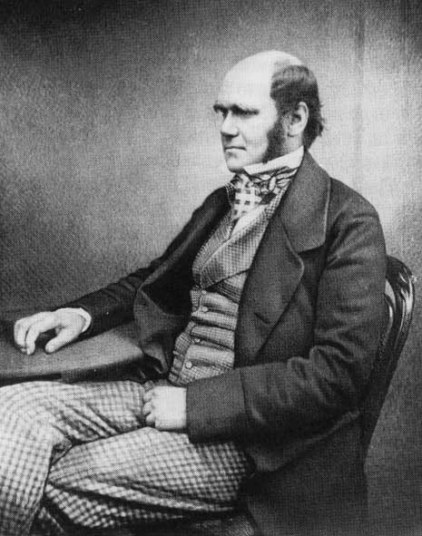
Charles Darwin
Proposed a way how evolution works
  How did creatures change over time?
  by natural selection
Collected a lot of evidence to support his ideas
  1809-1882
  British naturalist
Notes:
What did Darwin say?
What evidence supports Evolution by Natural Selection?
What impact did Evolution have on biology?

Slide 3
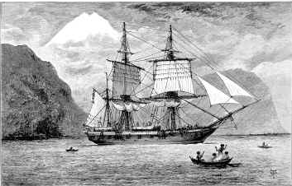
Voyage of the HMS Beagle
Invited to travel around the world
  1831-1836 (22 years old!)
  makes many observations of nature
    main mission of the Beagle was to chart
    South American coastline
Robert Fitzroy
Notes:
After graduation Darwin was recommended to be the conversation companion to Captain Robert FitzRoy, preparing the survey ship Beagle for a voyage around the world.
FitzRoy chose Darwin because of his education, his similar social class, and similar age as the captain.
Darwin noted that the plants and animals of South America were very distinct from those of Europe

Slide 4
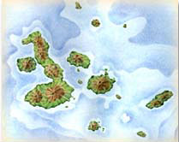
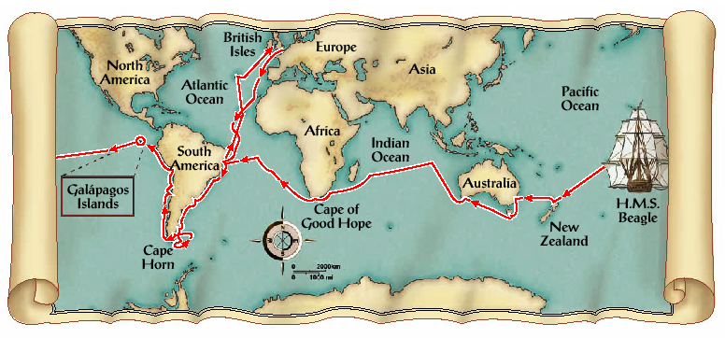
Voyage of the HMS Beagle
Stopped in Galapagos Islands
  500 miles off coast of Ecuador
Notes:
The origin of the fauna of the Galapagos, 900 km west of the South American coast, especially puzzled Darwin.
On further study after his voyage, Darwin noted that while most of the animal species on the Galapagos lived nowhere else, they resembled species living on the South American mainland.
It seemed that the islands had been colonized by plants and animals from the mainland that had then diversified on the different islands

Slide 5
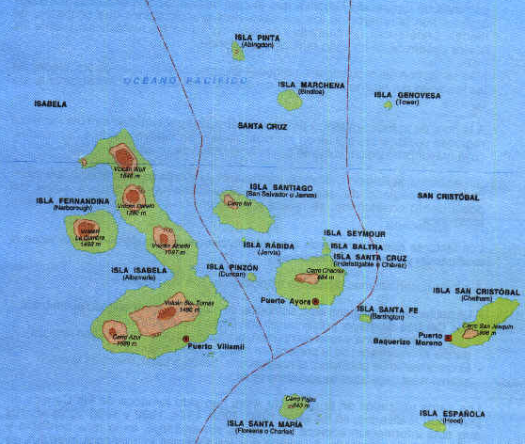
Galapagos
Recently formed volcanic islands. Most of animals on the Galápagos live nowhere else in world, but they look like species living on South American mainland.
800 km west of Ecuador

Slide 6
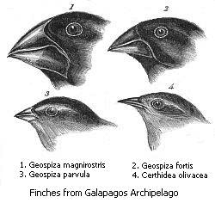
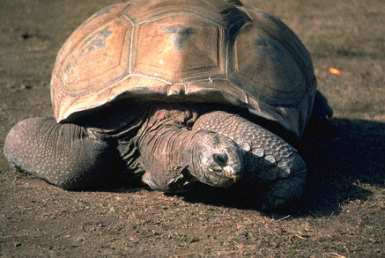
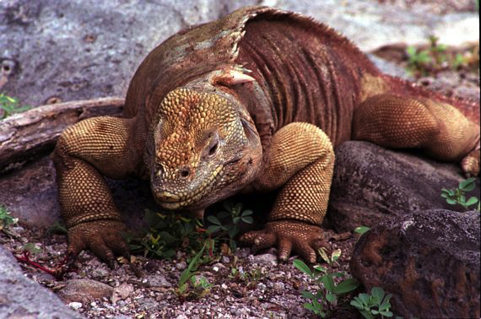
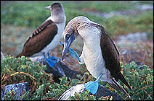
Darwin found…many unique species
Many of Darwin’s observations made him wonder… Why?
Darwin asked:
Why were these creatures found only on the Galapagos Islands?

Slide 7
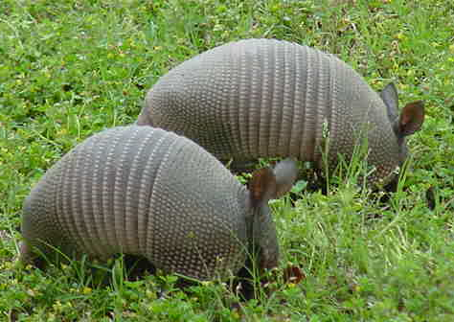
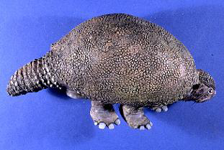
Darwin found…clues in the fossils
Darwin found:
Evidence that creatures have changed over time
present day Armadillos
Darwin asked:
Why should extinct armadillos & modern armadillos be found on same continent?
ancient Armadillo

Slide 8
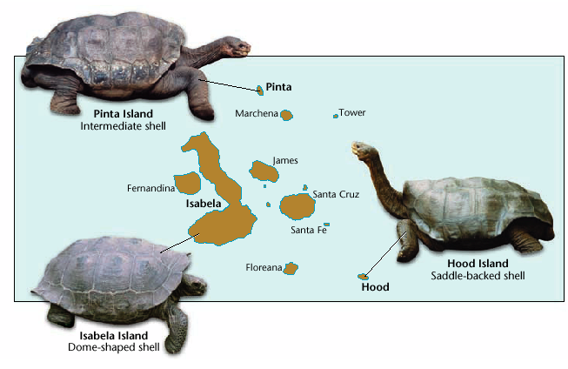
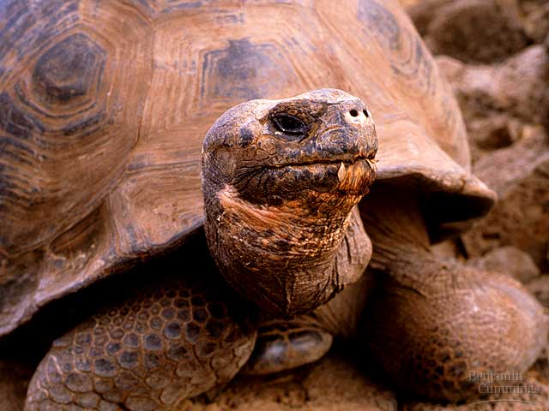
Darwin found:
Different shells on tortoises on different islands
Darwin asked:
Is there a relationship between the environment & what an animal
looks like?

Slide 9
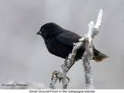
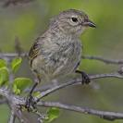

Darwin found… birds
Darwin found:
Many different birds on the Galapagos Islands.
He thought he found very different kinds…
Finch?
Finch?
Sparrow?
Sparrow?
Warbler?
Woodpecker?
Warbler?
Woodpecker?

Slide 10
But Darwin found… a lot of finches
Darwin was amazed to
find out:
All 14 species of birds
were finches…
But there is only one species of finch on the mainland!
Darwin asked:
If the Galapagos finches came from the mainland, why are they so different now?
Large ground
finch
Small ground finch
Finch?
Sparrow?
Finch?
Sparrow?
Warbler finch
Tree finch
Woodpecker?
Warbler?
Woodpecker?
Warbler?

Slide 11
The finches cinched it!
different beaks are inherited variations
serve as adaptations
that help birds compete for food
these birds survive & reproduce
pass on the genes for those more fit beaks
over time nature selected for different species with different beaks
Darwin found:
The differences between species of finches were associated with the different food they ate.
Darwin said:
Ahaaaa!
A flock of South American finches were stranded on the Galapagos…
Large ground
finch
Big seed eater
Small ground finch
Finch?
Small seed eater
Sparrow?
Warbler finch
Insect eater
Tree finch
Leaf & bud eater
Woodpecker?
Warbler?

Slide 12
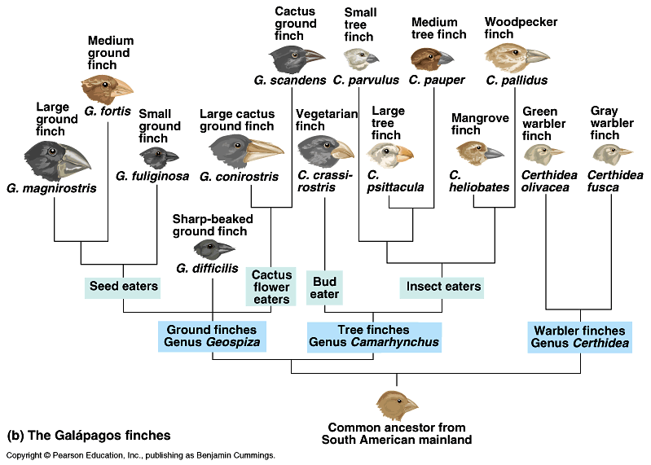
Relationship between species (beaks) & food

Slide 13

Darwin’s finches
Darwin’s conclusions
  variations in beaks
    differences in beaks in the original flock
    adaptations to foods available on islands
  natural selection for most fit
    over many generations, the finches were selected for specific beaks & behaviors
  offspring inherit successful traits
    accumulation of winning traits:
    both beaks & behaviors
  separate into different species

Slide 14
From 1 species to 14 species…
Warbler finch
Cactus finch
Woodpecker finch
Sharp-beaked finch
Small
insectivorous
tree finch
Warbler
finch
Small
ground
finch
Large
insectivorous
tree finch
Cactus
eater
Tree finches
Medium
ground finch
Ground finches
Insect eaters
Seed eaters
Large
ground
finch
Vegetarian
tree finch
Bud eater
natural selection for best survival & reproduction
variation

Slide 15


Ideas that shaped Darwin’s Thinking
James Hutton and Charles Lyell
  Geologists
  Realized that the earth was many millions of years old, and had been slowly changing over time
  Darwin asked if the earth was so old and was changing over time, might life be changing as well?

Slide 16
Earlier ideas on Evolution
LaMarck
  evolution by acquired traits
    creatures developed traits during their lifetime
    give those traits to their offspring
  example
    in reaching higher
    leaves giraffes stretch their necks & give the acquired longer neck to offspring
  not accepted as valid

Slide 17
Darwin’s view of Evolution
Darwin-
  giraffes that already
  have long necks
  survive better
  leave more offspring who inherit their long necks
  Fitness: the ability of an individual to survive and reproduce in that environment

Slide 18
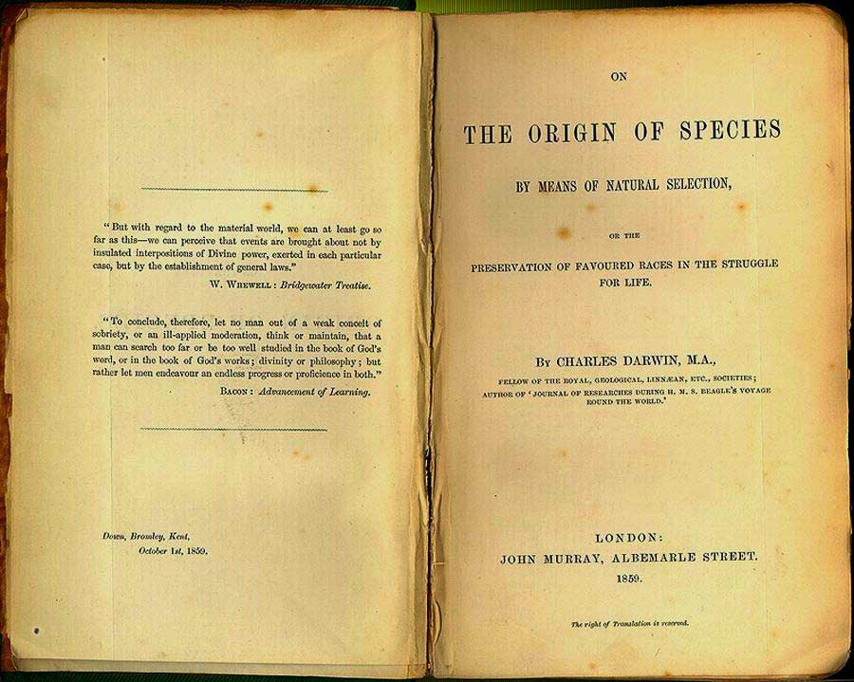
Voyage: 1831-1836
November 24, 1859, Darwin published
“On the Origin of Species by Means of Natural Selection”

Slide 19
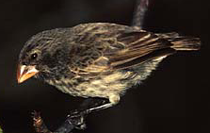
Essence of Darwin’s ideas
Natural selection
  variation exists in populations
  over-production of offspring
    more offspring than the environment can support
  competition
    for food, mates, nesting sites, escape predators
  differential survival
    successful traits = adaptations
  differential reproduction
    adaptations become more
    common in population

Slide 20
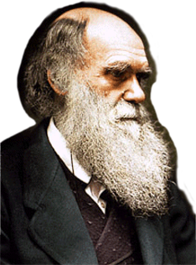
Asking Questions
is a good adaptation!

